Slide 1
THE FUTURE OF LIGHT MEASUREMENT
Casper Gammel
Viso Systems
Denmark
Notes:
Welcome to the presentation.
My name is Casper Gammel I am the manager of the R&D department at Viso Systems in Denmark.
And im gonna talk about the future of Light Measurment.

Slide 2
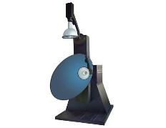
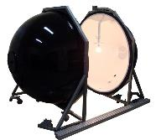
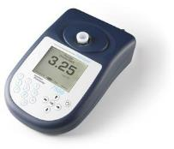
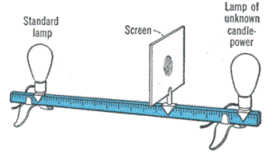

History of light measurement
Photometry measures light radiation in terms of perceived brightness to the human eye. Main characteristic of light is luminous flux.
Early days, eye estimation
Mid 1850’s,
Bunsen’s photometer
Around 1920
The first integrating
sphere
Late 1960’s, photometers and
lux meters
1980’s first mirror Gonio photometers
Angular distribution
Notes:
First I would like to re-cap on the history of light measurement. In this slide we can see how we measured light during history.
Of cause the first light measurement device was our eye.
Second we would compare a known light source with an unknown light source to get light intensity values.
In the 1920 we started using integration spheres to measure luminous flux. (Meaning that luminous intensity is light in one direction (candela) or point (lux) whereas luminous flux is the total amount of light in lumen in all directions.)
Later in 1970 we got luxmeters (luminous intensity)
And later in 1980 photo goniometers gave the possibility to measure beam angle and beam shape of a lamp and producing IES files.

Slide 3
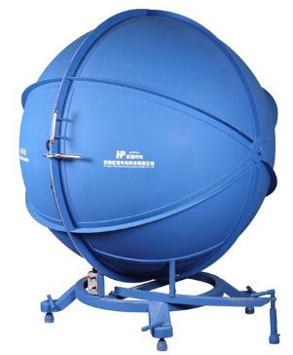
Integrating spheres
Main Equipment used today
Luminous flux (lumen) coming from all directions of a light source - spherical shape integrates the light inside.
Inside of the sphere is covered with a diffuse reflective surface.
Notes:
The main instrument used today to measure lamps is the integration sphere.

Slide 4

Integrating spheres
Adding a spectrometer to a integrating sphere gives more data
Lumen
Color temperature
CRI
Spectrometer
Notes:
In a integration sphere is the light reflected in all direction so that the light is spread equally along the surface of the sphere which we then can measure and calculate the total output in lumen.
The sphere can also give further information if equipped with a spectrometer like color temperature, color rendering indexes.

Slide 5
Measuring procedure of Integrating spheres
Form calibration with out light source
Form calibration with light source
Primary calibration
Measurement
Notes:
Even if the concept of the integration sphere is simple is the actual measurement process still fairly time consuming.
First the sphere must be calibrated using a special calibration lamp.
Second the sphere must be form calibrated with the auxiliary lamp turned on.
Third the sphere must be calibrated again with the auxiliary lamp, this time DUT using the mounted to compensate for the …
Fourth the actual measurement can be performed after the lamp has warmed up.
Not possible move preheated lamp fast onto sphere.

Slide 6
Integrating spheres
Results and further considerations
Pros
Good for measuring incandescent bulbs
Cons
Takes a long time for a single measurement.
Directional lights give large errors (7-10%) Hot spot
Linear lights needs huge spherical dimensions
No 3D information (no IES/LDT files)
Notes:
The sphere offers no beam information including IES data, and is therefore becoming more and more obsolete as the world get more digital and as new regulation requires new measurement technologies.
And even certain lamp types can be problematic to measure such as directional lamps as you can get hot spots in a sphere.

Slide 7

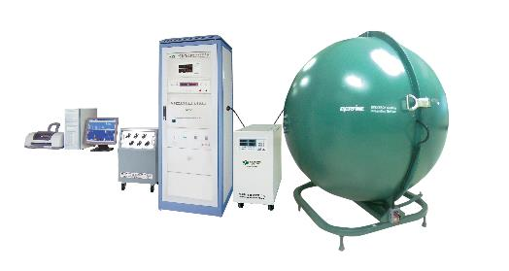
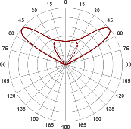
Goniophotometers
The most used solution brings all the photometric data, IES and LDT files
Integration sphere:
lumen values
+ photometric data if using a spectrometer
Goniometer:
Angular distribution
IES, LDT
Angular distribution is of high importance for the lighting industry: manufacturers, designers and engineers need this information for 3D modelling.
Notes:
The solution mostly used now to solve the limitations of the sphere is to add a photo goniometer and make measurement first in the sphere and the move the lamp to the goniometer to get you beam information in IES format.
The method does give you most of the photometric but is quite time consuming as two systems has be used.

Slide 8
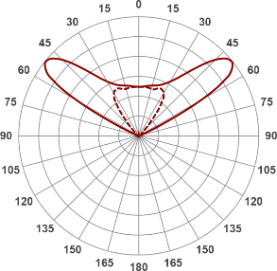
Goniophotometers
Typical systems include a photo-sensor + goniometer.
Intensity in candela
Angular distribution
IES and LDT files
Ang/C-plan | 0 | 5 | 10 | 15 | 20 | 25
0 | 873,5683 | 873,5683 | 873,5683 | 873,5683 | 873,5683 | 873,5683
1 | 874,6646 | 874,6746 | 875,974 | 876,3697 | 877,5536 | 877,5846
2 | 875,7609 | 877,1144 | 878,3796 | 880,3233 | 881,5389 | 883,1025
3 | 876,9303 | 879,5541 | 880,8093 | 884,2769 | 885,5242 | 888,6204
4 | 880,013 | 881,9939 | 885,5896 | 888,2305 | 891,8943 | 894,1384
5 | 883,0957 | 886,28 | 890,3699 | 894,118 | 898,6414 | 901,2567
6 | 886,1784 | 891,314 | 895,1503 | 900,4158 | 905,3885 | 909,1572
7 | 889,9412 | 896,348 | 900,6319 | 906,7136 | 912,4092 | 917,0578
8 | 894,9252 | 901,3915 | 907,5309 | 913,1996 | 920,7552 | 924,9584
9 | 899,9092 | 906,9208 | 914,43 | 920,8501 | 929,1012 | 933,8423
10 | 904,8933 | 912,45 | 921,329 | 928,5005 | 937,4472 | 942,7337
11 | 909,6931 | 917,9792 | 927,8678 | 936,151 | 945,6382 | 951,625
12 | 914,4 | 923,5551 | 934,2142 | 943,741 | 953,6691 | 960,5297
13 | 919,1071 | 929,2212 | 940,5606 | 951,2599 | 961,7001 | 969,4634
14 | 923,8141 | 934,8873 | 946,907 | 958,7789 | 969,731 | 978,3972
15 | 928,5887 | 940,5535 | 953,2214 | 966,2979 | 978,0482 | 987,3309
16 | 933,3644 | 946,1473 | 959,5344 | 973,7429 | 986,4312 | 997,5172
17 | 938,14 | 951,7041 | 965,8475 | 981,1663 | 994,8142 | 1008,468
18 | 943,4874 | 957,2609 | 972,4881 | 988,5898 | 1003,323 | 1019,418
19 | 950,1255 | 962,8176 | 979,9695 | 996,2387 | 1012,751 | 1030,369
20 | 956,7635 | 971,7907 | 987,4509 | 1006,208 | 1022,18 | 1042,339
21 | 963,4016 | 980,8505 | 994,9323 | 1016,177 | 1031,608 | 1054,372
22 | 973,9025 | 989,9103 | 1006,878 | 1026,146 | 1044,864 | 1066,405
23 | 986,8259 | 1001,111 | 1021,785 | 1039,8 | 1062,966 | 1080,948
24 | 999,7493 | 1017,568 | 1036,692 | 1058,769 | 1081,067 | 1102,531
25 | 1012,673 | 1034,024 | 1051,599 | 1077,738 | 1099,168 | 1124,113
26 | 1031,796 | 1050,48 | 1073,795 | 1096,707 | 1122,766 | 1145,695
27 | 1051,347 | 1071,494 | 1096,723 | 1121,647 | 1148,078 | 1171,55
28 | 1070,899 | 1095,415 | 1119,651 | 1148,867 | 1173,389 | 1200,623
29 | 1091,986 | 1119,337 | 1144,323 | 1176,087 | 1199,313 | 1229,695
30 | 1117,528 | 1143,258 | 1174,847 | 1203,679 | 1233,398 | 1258,768
Intensity in candela for certain number of angles for a lamp
Notes:
A typical photo goniometer gives you the intensity in candela for certain number of angles for a lamp.
The photo-meter consist of photosensor and a filter which approximated to match the luminous sensitivity of the eye.

Slide 9

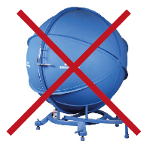
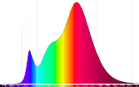
New technology
Typical systems include a photo-sensor, goniometer and a spectrometer
Photometer
New technology: Future proof all-in-one measuring solution includes spectrometer and a goniophotometer
Spectrometermeter
Color deviation along the beam, intensities in PPFD (photon flux density) and much more.
Notes:
But if we exchange the photometer with spectrometer can we suddenly make the goniometer output much more data and in fact make the integration sphere obsolete.
With a spectrometer sensor we now have one system which can output all photometric data in one system and in fact gives even more data such color deviation along the beam, intensities in PPFD (photon flux density) for agricultural and much more.
Basically the data measurement with such as system will future prof any measurement you do for an upcoming regulation.

Slide 10
Goniospectrometers measuring parameters
Data from a Goniospectrometer
Beam angle
3D visualisation
Light distribution curve
Beam angle
IES and LDT files
Luminous flux (lumen)
Light intensity (candela)
CRI, TM30, CQS
CCT
Integrated Spectrum
Power and power factor
Efficiency (lm/watt)
UGR
PPF
PPFD
Color deviation
Integrated spectrum
Notes:
Here is a list of measurement results you would get from such a system.
You can see how the measurement area easily can be limited to a 120 degree cone to comply with European regulations.
But also the spectrum is a combination of all measured spectrum giving us the same integrated spectrum we would get from the sphere.

Slide 11
IES and LDT
Future proof IES and LDT files with color information
Notes:
A spectro goniometer will also give you fully compliant IES and LDT files.
And as the 3D rendering technology develops and color information easily be implemented by using measurements from a spectro goniometer.

Slide 12
New EU regulations pushing the technology
Environmental concerns calls for new regulations
Example from EU
Lumen from a directional lamp must only be measured in 90° or 120° cones.
Definition of a directional lamp:
At least 80% of the light is radiated into a fixed beam angle (90° or 120° cones).
Cannot be done in an integrating's sphere
Notes:
Just to mention a bit about the European regulation for directional lamp.
The lumen must now only be measured in 90 or 120 degree cone to ensure the lumen specified is forward light and not a part of the wasted back light.
This regulation in it self actually renders the integration sphere useless for measuring the lumen value as it can only be done in a photo/spectro goniometer.

Slide 13
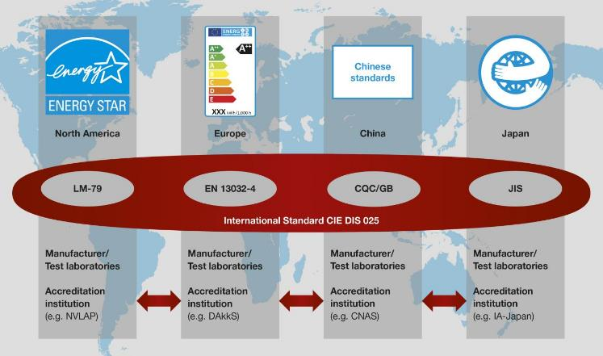
CIE DIS 025 International standard
Globalizations calls for international standards
Many of the most demanding requirements
Lets compare LM79 with the new S 025
Notes:
There has been a lot of work done to simplifi the measurement standard.
Until 2015 there as not been an international standard but instead every region has had their own standard.
But in 2015 the CIE S 025 international standard was released.
The S 025 has been created by taking the strictest requirement of each regional standard and combining them into the new S 025.

Slide 14
LM79 Standard
Old requirement of LM79 is more strict than S 025, due to big change in fluorescent and high pressure sodium lamp
Mirror goniometer
Nearfield goniometer
Pros:
Lamp mounted in operating position
Both up and down measurements
Fluorescent + high pressure sodium lamp
Cons:
Takes a long time for a single measurement
Difficult to operate
Need a big black room
Large footprint + rack
Stray light can occur
Long distance to sensor (mirror)
Nearfield goniometer not recognized by any standard
Difficult to include spectrometer
Notes:
There are some less restrictive measurements in the S 025 compared to for example the north American LM79 standard.
The LM79 requires the lamp to be in the operating position during measurement as some types of lamp can change output depending on orientation.
For example can fluorescent and high pressure sodium lamp change output by up to 5% depending on orientation.
To make compliant measurements must large mirror type goniometers be used which are very costly and requires a lot of space.
A nearfield goniometer using a camera can also be used but as it is nearfield technology, the far field must be calculated, as IES files can only contain far field data.
All calculations must be included in the documentation which makes this type of measurement system difficult to comply with standards.

Slide 15
Mirror Goniometer setup
Mirror goniometers are not easy to operate and install
Notes:
Yes mirror goniometers are not easy to operate and install.

Slide 16
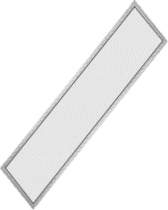
CIE DIS 025 Standard
New standard now allows for movement of LED lamps
Pros:
DUT in non-operating position
Easy to operate
Fast measurements
No need for a black room
Small footprint
Can operate in ambient light
No big racks
Only a computer is needed
Cons:
Lamp is being rotated
Stray light can occur
Long distance to sensor
Lamp dia x 5 - 15
Type-C Horizontal Goniometer
Notes:
The S 025 now allows for the measurement of a lamp to be done in non-operating positions.
These less strict requirements has been implemented in the S 025 because LED technology is not affected significantly by the lamp orientation.
Being able to move the lamp during the measurement makes the system setup and operation much simpler than before.
We call such as system a type-c horizontal goniometer.

Slide 17
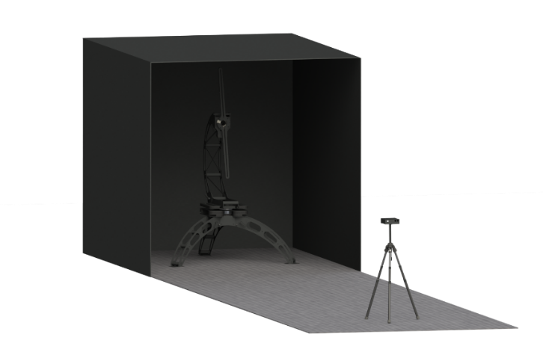
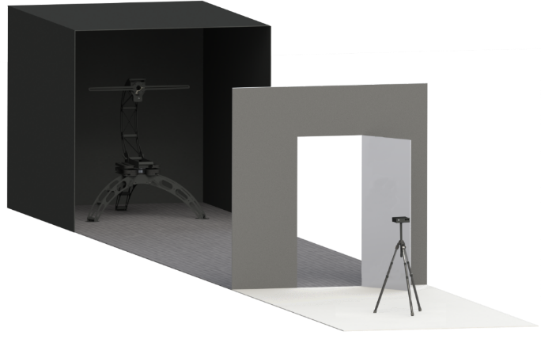
Measurement environment
Black room is now only necessary around the goniometer, using a directional sensor.
Notes:
Adding directional sensor technology to a type-c horizontal goniometer will make the installation and operation even simpler as only the area around the goniometer needs to be black instead of the whole room.

Slide 18
Horizontal measurement correction
Monitoring the lamp from operating position
Stabilize in operating position
Move to measuring position
Measure the change in output
Lm
min
High power lamps with
directional heatsinks tend to
change the most
But the drop in lumen is no more than 0 – 1.2%
Notes:
As mentioned before is LED lamp not affected much by lamp orientation, but a simple test can still be performed to determine how much a LED lamp is affected.
First set the lamp in the operating position for and extended amount of time, then move it to the goniometer and monitor the change.

Slide 19
Deviation in lumen
Deviation in lumen on the tested
objects when orientation was
changed to horizontal was between
0.47 – 0.99%
A comparison from DTU
(Technical University of Denmark)
For most this deviation will be
insignificant
Notes:
This slide shows how much the intensity of typical LED lamp are affected by orientation.

Slide 20
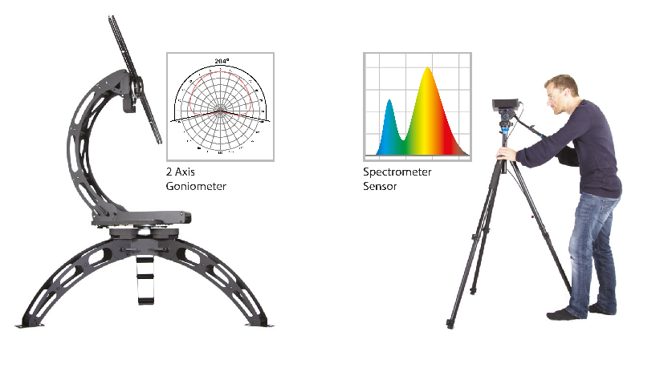
Making light measurement easy
Any questions or suggestions are most welcome
or visit us at booth F19 Hall 4
Notes:
Thank you and please let me know of any questions you might have.
Please visit us at booth F19 Hall 4

Slide 21
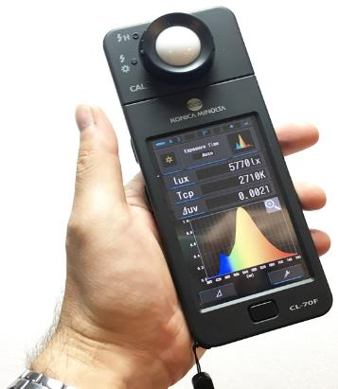
Point color measurement
Integrated
2700K
Beam color is not uniform
2500K
2800K
3100K
Notes:
This slide shows the color deviation in a light beam.
So for example the color temperature cannot be measured in just a point with a handheld device, but a complete measurement has to be done, to integrate all the light.

