Slide 1
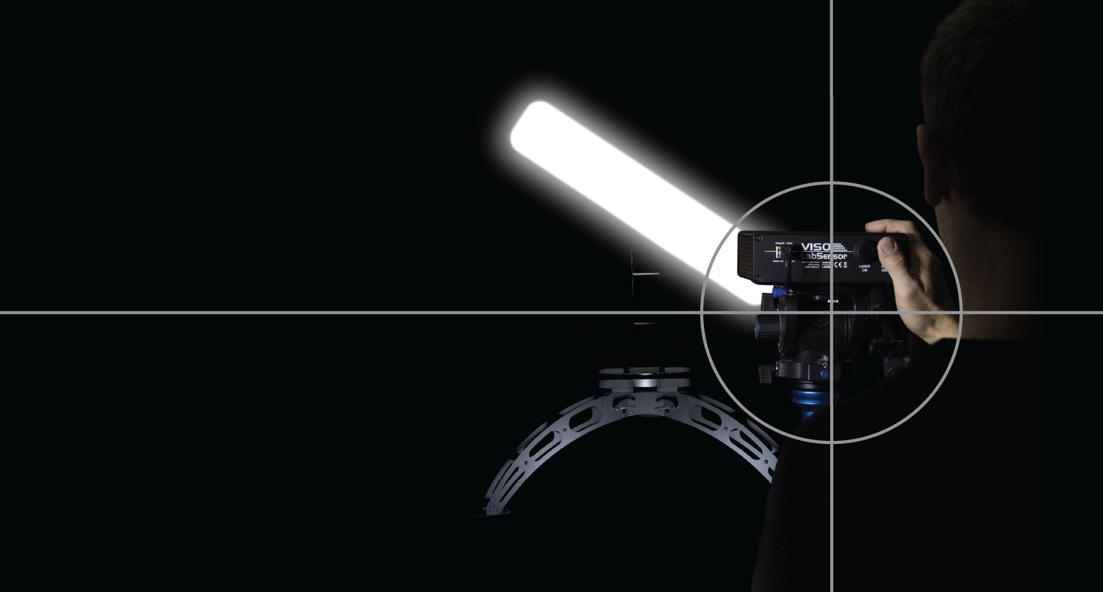

Future of light measurement

Slide 2
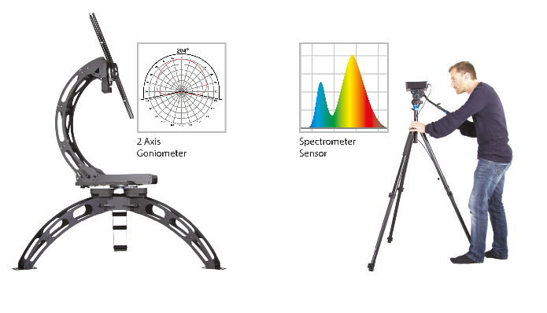
Did you know?
Viso Systems created a Light Measurement System which is:
The fastest
Most Integrated
Easiest
Able to generate custom reports
Well priced

Slide 3
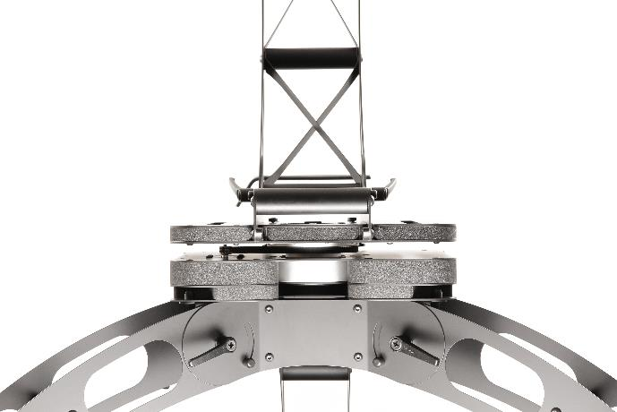
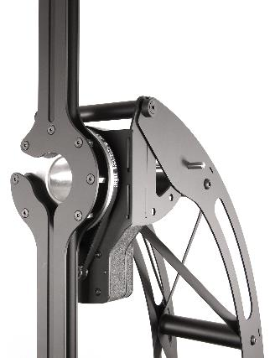
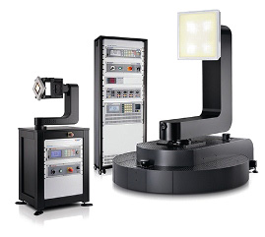
Fastest
Viso continuously moving
Other system
No sudden moves resulting in simple mechanical structure
Other system
Large mechanical structure

Slide 4
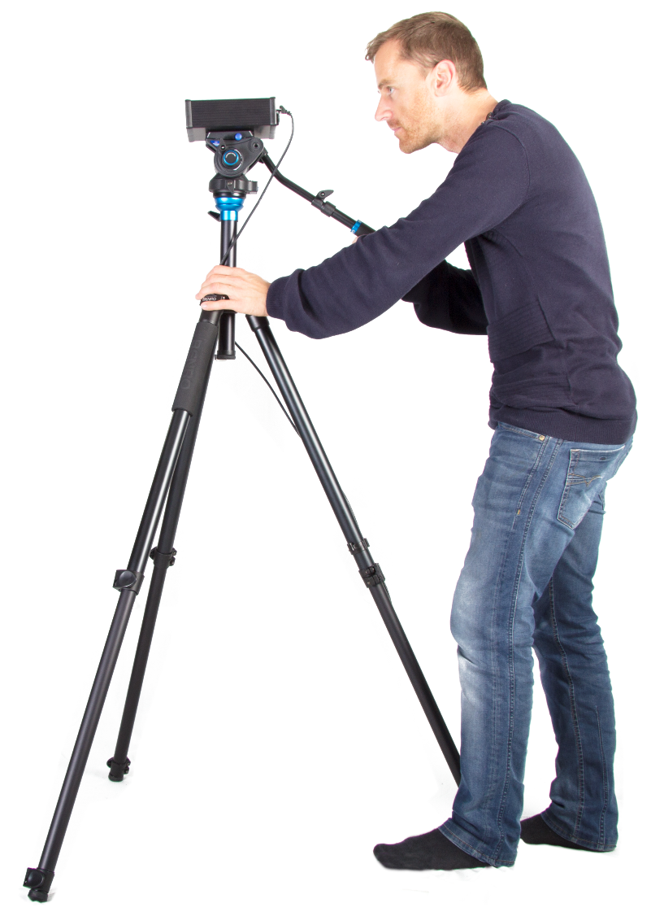
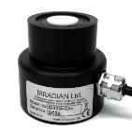
Fastest
Viso continuously moving
Other system
Fast directional spectrometer sensor
Other system
Mostly only photosensor

Slide 5
Fully Integrated
Viso Systems integrates:
Every system includes the power analyzer
Intuitive Software
A complete plug and play solution
No need for a dark room

Slide 6
Reporting made simple
Viso Systems reports are:
Fully editable template
Created from a drag and drop menu
Include custom charts from excel
Demo from Light Inspector

Slide 7
Complete range
System range
Accessoires and software

Slide 8
Well price – also with China
Everfine GO-2000A vs Viso LabSpion comparison
System comparisons: | GO-2000A | Viso LabSpion
Goniometer resolution | 0.1° | 0.1°
Continues moving system | No (Long measurement time) | Yes (Short measurement time)
External control racks | Yes | No (All build in)
Customizable able PDF reports | No | Yes (Create your own report templates)
Calibration lamp included | No (buy seperate) | Yes
Power analyzer build-in | No (buy seperate) | Yes
Spectrometer included | No (buy seperate) | Yes
Completely dark room needed | Yes | No (Only around the goniomter)
Far field | Yes | Yes
Maximum lamp weight | 60Kg | 25Kg (Directly on base without auto c-plane 60Kg)
Maximum lamp diameter | 200 cm | 150 cm (Directly on base without auto c-plane 500cm)
Measurement capabilities: | GO-2000A without spectrometer | GO-2000A with spectrometer | Viso LabSpion
Lumen | Yes | Yes | Yes
Color temperature | No | Yes | Yes
CRI and other color renderings | No | Yes | Yes
Peak Intensity | Yes | Yes | Yes
Beam angle | Yes | Yes | Yes
Polar light distribution | Yes | Yes | Yes
3D IES, LDT files for Dialux etc. | Yes | Yes | Yes
Color consistency | No | Yes | Yes
Power effeciency from electrical to radiated | No | Yes | Yes
Price | 35.000,- EUR | 52.500,- EUR | 45.000,- EUR

Slide 9
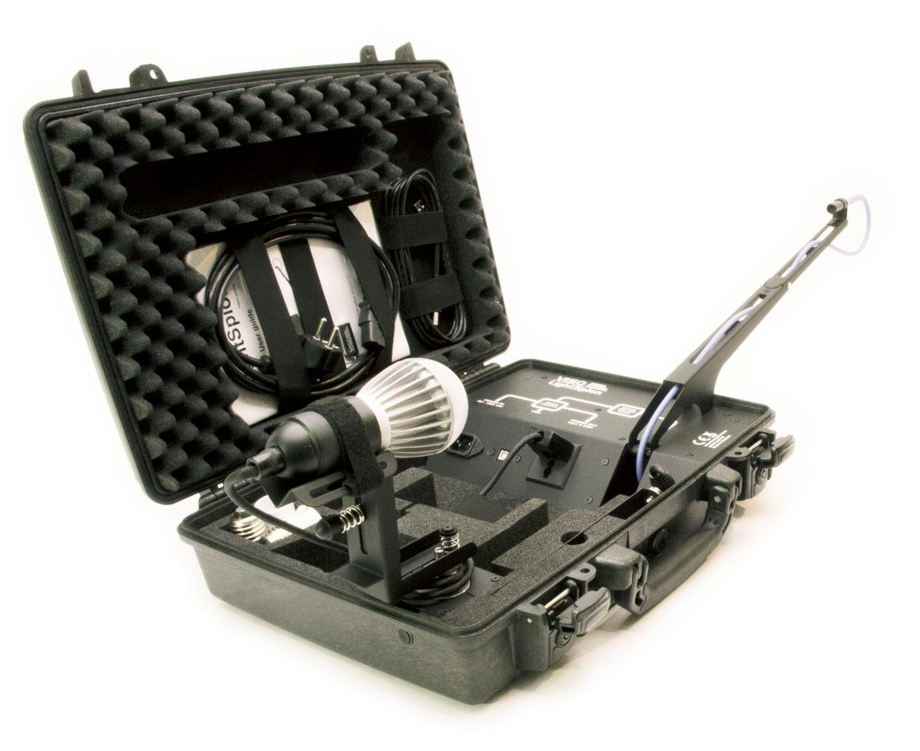
LightSpion no competition

Slide 10
Compliance with measurement standards
All Viso measurement solution are CIE S:025 compliant
CIE S:025 is in Europe called EN13032-4

Slide 11
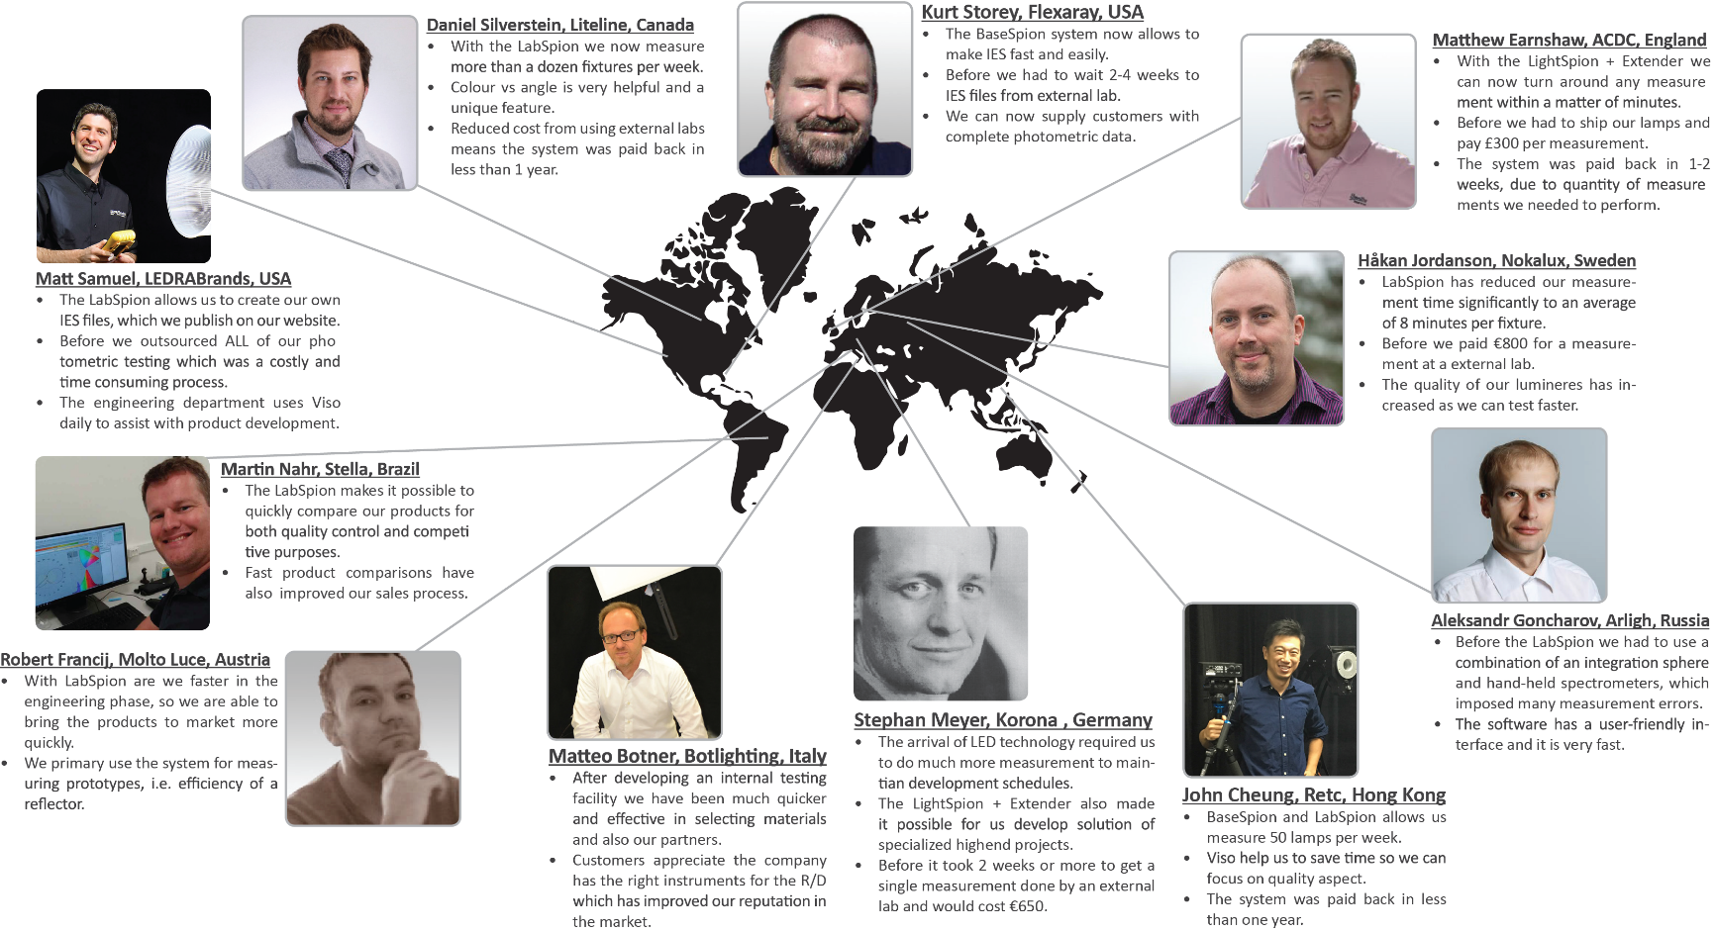
Reviews from around the world

Slide 12
Thank you
Please ask some questions

